Slide 1

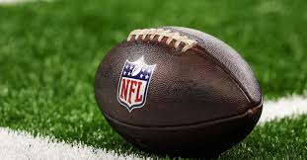
Capstone Project :
Exploring NFL Statistics
JORDAN BAKER
DATA 205 CAPSTONE PROJECT

Slide 2
GOALS AND QUESTIONS
My primary focus for this project is to explore Rushing and Passing Statistics from the 2019 to 2023 NFL seasons
01.
PRIMARY GOAL
How has the league changed in 5 years?
02.
Question
Is there any correlation between the rushing data and the passing data?
03.
Question

Slide 3

DATA OVERVIEW
ALL SOURCED FROM PRO-FOOTBALL-REFERENCE
SCRAPED BY NFLscraPY
Main dataset(s): Stats
Includes variables such as total passing yards, rushing yards, touchdowns, turnovers, passer rating, and more
Secondary datasets: Drives, Scoring, Season
Every dataset is already cleaned and organized

Slide 4
Data & Wrangling
“Stats_2019” -” Stats_2023”
Concatenated to one big dataframe: “stats”
01.
Created Main Dataframes
Passing dataframes
Rushing Dataframes
02.
Created Specialized Dataframes
Added column ‘rush_avg’
Added column ‘pass_avg’
Added column ‘rush_success’
03.
Added efficiency stats

Slide 5
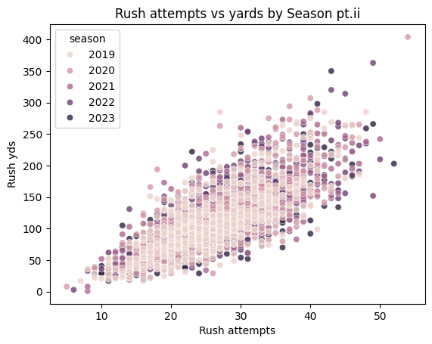
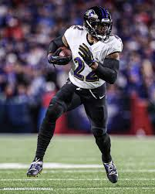
PART 1A: League RUSHING
The distributions across each season are extremely similar
Extreme data overlap
Very little league-wide variation.

Slide 6
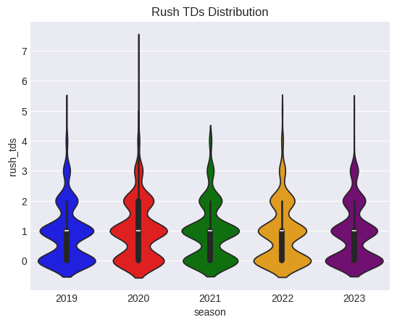
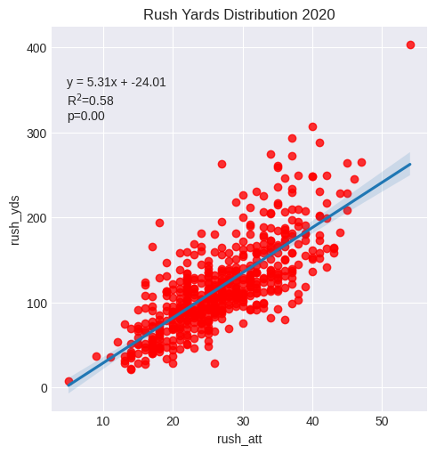
PART 1A: League RUSHING
Each season has an R² of around .60, ranging from .57 to .62.
Each season had an average of about 5.3 -5.4 yards per attempt.

Slide 7
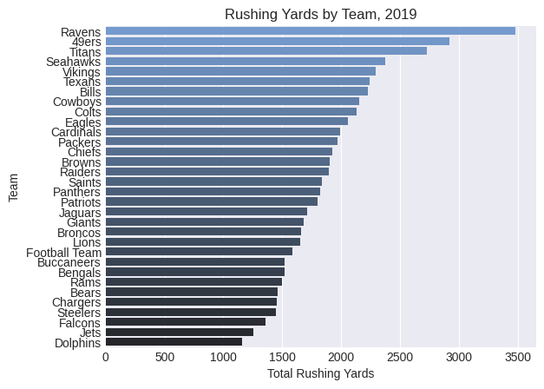
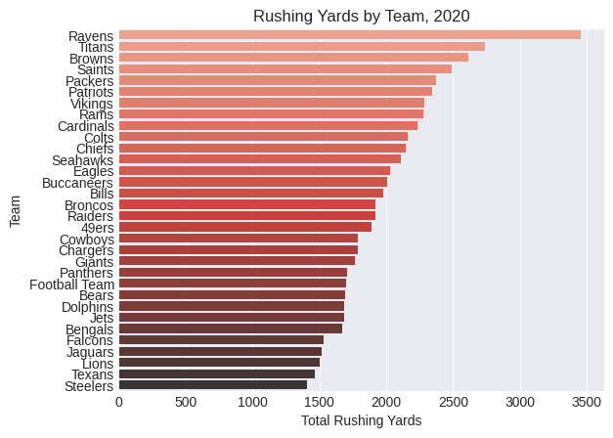
PART 1B: Team RUSHING
Some notable teams include:
- The Ravens are always in the top five and are the #1 rushing team 3 out of the five years.
- The Titans, were top 3 in total rushing yards from 2019 to 2021, but were league average in 2022 and 23.
- The 49ers, ranked in the top 5 for 4 out of the 5 seasons.
- The Eagles are consistently top ten, while the Buccaneers are consistently bottom ten, despite both teams winning a Super Bowl in this era.

Slide 8
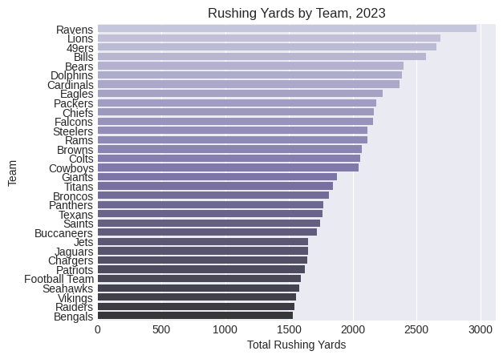
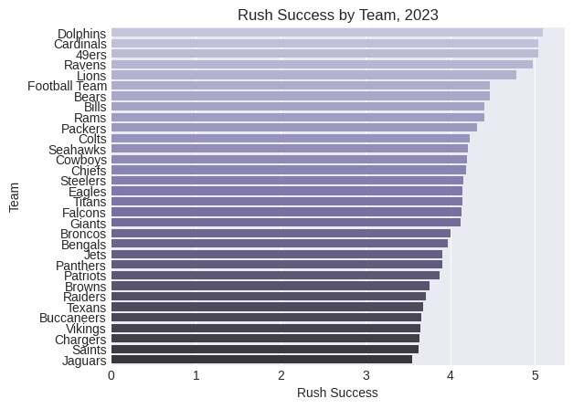
PART 1B: Team RUSHING
- The Ravens, who I said before was undoubtedly the best rushing team in this time period, had by far the best rushing success in 2019 and 2020 as expected, but they were outside of the top three in 2023, despite leading the league in total rushing yards.
- The Buccaneers, who I mentioned were bottom 10 in total rushing yards in each of the 5 seasons, actually were league average in rushing success in 2021, before plummeting to the worst rushing team in the league the following season.

Slide 9
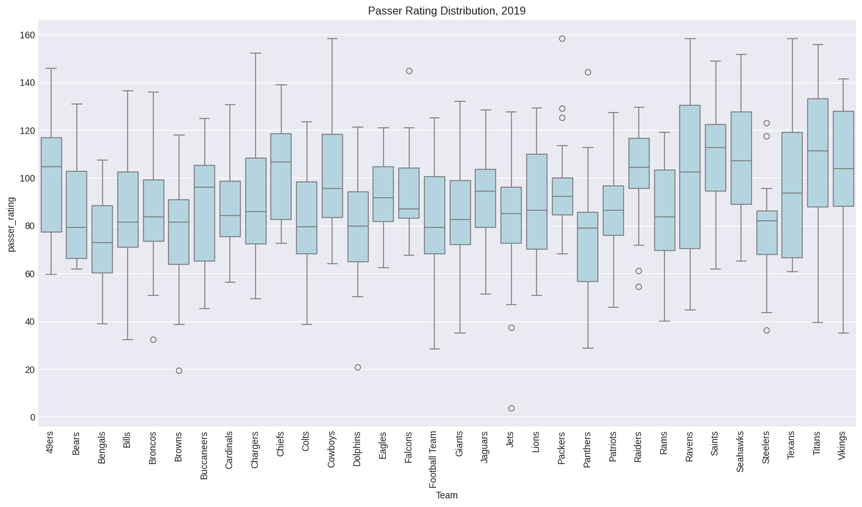

PART 2A: League PASSING

Slide 10
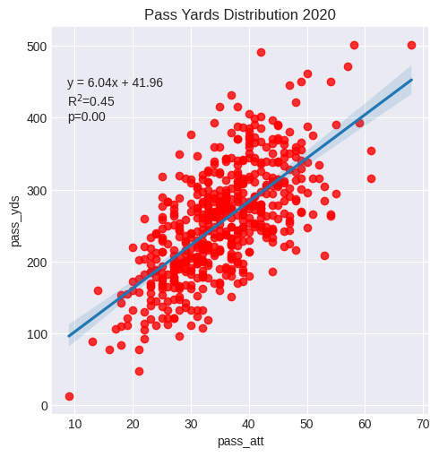
PART 1A: League PASSING
There is greater variation in the passing data
Average R² value of 0.4 compared to 0.59
Average slope of 5.67 compared to an average of 5.21
Similar spread of slopes; 0.61 spread compared to .54

Slide 11
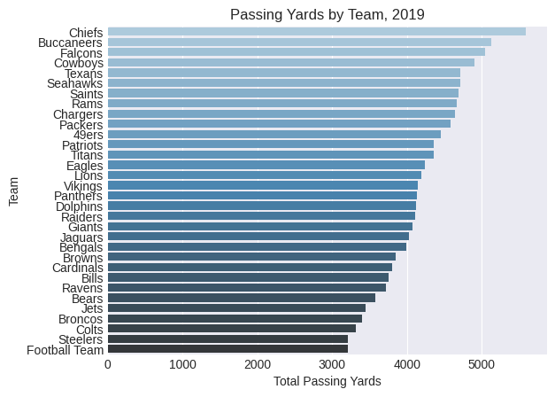
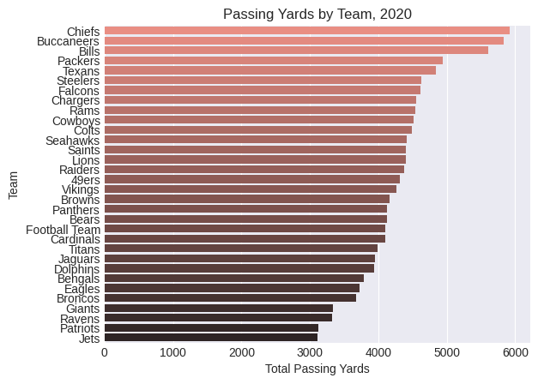
PART 2B: Team PASSING
Some notable teams include:
- The Chiefs led the league in total passing 3 out of the 5 years and didn’t rank lower than 2nd
- The Buccaneers also saw incredible passing success in this 5 seasons, ranking in the top 3 in 4 out of the 5 seasons and 6th in 2023.
- The Jets on the other hand, ranked bottom 5 in total passing yards in three seasons, including ranking dead last in 2020.
- The Ravens, in spite of their rushing success, ranked in the bottom 10 in total passing 3 out of 5 seasons, peaking at league average 16th in 2023.

Slide 12
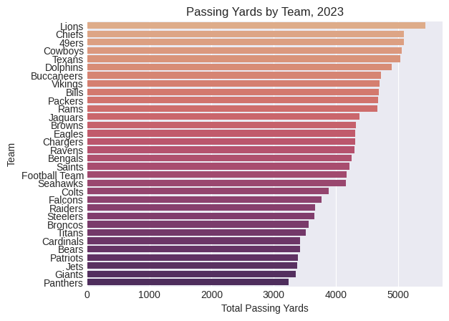
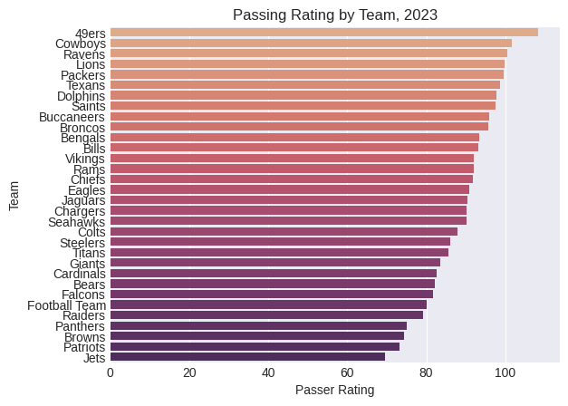
PART 2B: Team PASSING
- The Chiefs ranked in the top 5 for passer rating, 4 out of the 5 seasons but fell closer to league average in 2023 after leading the league in 2022.
- The Jets ranked in the bottom 5 every season. Even the season they were around league average in total passing, they ranked second-to-last in passer rating. (yikes!)
- In 2019, the Titans led the league in passer rating, which is quite surprising from a team with Derrick Henry, who ran for over 1500 yards and 16 tds, had two different starting QB's, and only won 9 games.
Notes:
- There is quite a bit of variation in these graphs. As we mentioned before, the average passer rating for the league only had a spread of about 6 points in these 5 seasons, but the teams that are actually good and bad change significantly from year to year.

Slide 13
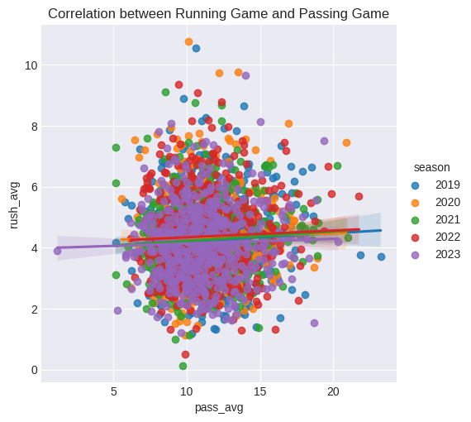
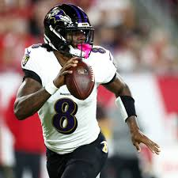
PART 3: Correlation
Notes:
- There is quite a bit of variation in these graphs. As we mentioned before, the average passer rating for the league only had a spread of about 6 points in these 5 seasons, but the teams that are actually good and bad change significantly from year to year.

Slide 14
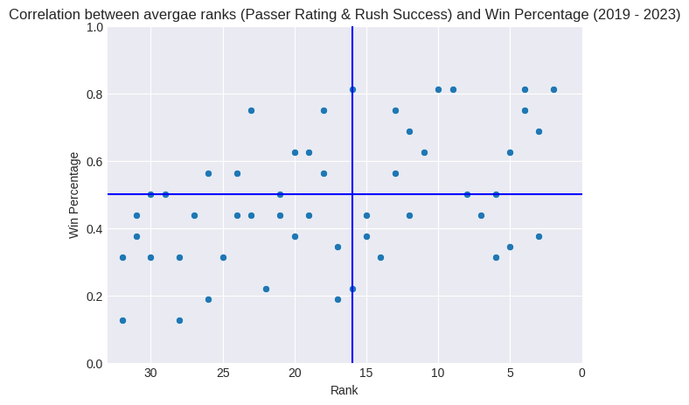
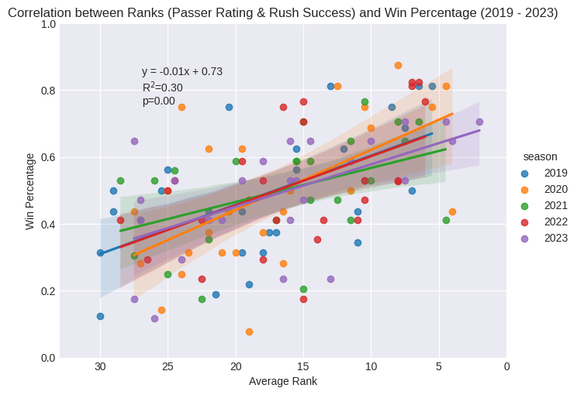
PART 3: Correlation
Notes:
- There is quite a bit of variation in these graphs. As we mentioned before, the average passer rating for the league only had a spread of about 6 points in these 5 seasons, but the teams that are actually good and bad change significantly from year to year.

Slide 15
CONCLUSIONS
01.
Not a big difference in league rushing or passing data year to year but,
big difference in the specific team rankings for both passing and rushing.
02.
There is no evidence to support a correlation between a good running game and a good passing game. Being successful at one does not equate to success in the other.
03.
- Offense as a whole is only one part of the game of football, so a team with high offense rankings doesn't automatically mean they will have a high win percentage

Slide 16

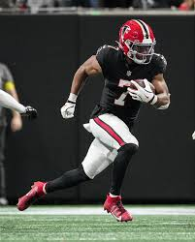
FUTURE STEPS
Explore the defensive statistics
Explore more years and more seasons of data and find trends
Work with advanced statistics, like EPA per play(Expected Points Added), and QBR (QB rating)
THE MORE VISUALIZATIONS THE BETTER!

Slide 17
THANK YOU!
ANY QUESTIONS??

